Slide 1

Ottawa Decision Support Framework:
Historical perspective
Annette O’Connor PhD FRSC FCAHS
Distinguished Emeritus Professor
University of Ottawa, Canada
Notes:
Hello Everyone
Thank you for the opportunity to provide a brief historical overview of the Ottawa Decision Support Framework.
I hope it provides you with a context for this workshop

Slide 2
The ODSF
Clinical need (1989-95)
Evolution (1995-96)
Current limitations
Notes:
My comments focus on three areas:
How the need for the Framework arose
How it evolved and its current elements
And finally, limitations that have sparked this 20th anniversary review

Slide 3

1. Clinical Need (1989-95)
Help clinicians learn how to support patients with difficult decisions
  Book chapters
  Lectures
  Clinical course: case studies; needs assessment requests from health care teams
This Photo by Unknown Author is licensed under CC BY-SA-NC
Notes:
The need arose from clinical practice when I was asked to help clinicians learn how to support patients who faced difficult decisions.
Requests included:
book chapters, lectures, and a clinical course…

Slide 4
Chapter: Decisional Conflict (’89-93)
Uncertainty about the best course of action when choice involves risk, loss, regret, challenge to personal life values
Modifiable factors: deficits in knowledge, values clarity, support
O’Connor, A., & O'Brien-Pallas, L.L. "Decisional Conflict", in G.K. McFarland and E.A. McFarlane (eds), Nursing Diagnosis and Intervention (Toronto: The C.V. Mosby Company, 1989, revised 1993.
O’Connor AM, D’Amico M. Decisional conflict. In McFarland GK, Thomas MD (eds). Psychiatric Mental Health Nursing: Application of the Nursing Process. Philadelphia: J. B. Lippincott, 1990.
Notes:
The book chapters focused on helping patients experiencing “decisional conflict”, a new addition to a taxonomy of nursing problems, which was based on Janis and Mann’s psychological construct.
It is personal uncertainty about the best course of action for decisions…. involving risk, loss, regret, or challenge to personal life values.
Although patients feel uncertain because of the inherent nature of the decision, uncertainty is exacerbated by modifiable factors such as: deficits in knowledge, values clarity and support.

Slide 5
Chapter: Decisional Conflict (’89-’93)
Uncertainty about the best course of action when choice involves risk, loss, regret, challenge to personal life values
Modifiable factors: deficits in knowledge, values clarity, support
O’Connor, A., & O'Brien-Pallas, L.L. "Decisional Conflict", in G.K. McFarland and E.A. McFarlane (eds), Nursing Diagnosis and Intervention (Toronto: The C.V. Mosby Company, 1989, revised 1993.
O’Connor AM, D’Amico M. Decisional conflict. In McFarland GK, Thomas MD (eds). Psychiatric Mental Health Nursing: Application of the Nursing Process. Philadelphia: J. B. Lippincott, 1990.
Notes:
The chapters also laid the foundation for a clinical practice framework using decision theories from psychology and economics as well as self care. Later I would broaden the social dimension of the theoretical underpinnings.
The framework focused on assessing decisional conflict and contributing factors, intervening to address contributing factors, and evaluating the effects of the interventions.
Evaluation was particularly challenging… what is a good decision when there is no clear best answer for everyone? I defined it as informed, congruent with personal values, and implemented.
Since there was little research involving patients who actually faced these decisions in clinical practice, I launched an interdisciplinary research program to assess their decisional needs, provide decision support, and evaluate the effects.

Slide 6
Chapter: Decisional Conflict (’89-’93)
Uncertainty about the best course of action when choice involves risk, loss, regret, challenge to personal life values
Modifiable factors: deficits in knowledge, values clarity, support
Clinical practice framework
  Assess
  Intervene
  Evaluate: decisions informed, congruent with values, implemented
PSYCHOLOGY
Janis IL, Mann L. Decision making. New York: The Free Press; 1977.
Tversky A, and Kahneman D. The framing of decisions and the psychology of choice. Science 1981; 211:453-58.
Tversky, A., & Kahneman, D. (1981). The framing of decisions and the psychology of choice. Science, 211(4481), 453–458.
Fischhoff B, Slovic P, Lichtenstein S. Knowing what you want: measuring labile values. In: Wallsten TS, editors. Cognitive processes in choice and decision behavior. Hillsdale (NJ): Lawrence Erlbaum Associates Inc.; 1980.
ECONOMICS
Keeney, RL. & Raiffa H. Decisions with multiple objectives: Preferences and Value Tradeoffs. New York: John Wiley and Sons, 1976.
SELF CARE
Orem DE. Nursing: Concepts of practice. 5th ed. Toronto: Mosby; 1995.
LATER: BROADEN SOCIAL DIMENSIONS Ajzen I, and Fishbein M. Understanding attitudes and predicting social behaviour. Englewood Cliffs: Prentice Hall; 1980.
Bandura A. Self-efficacy mechanism in human agency. American Psychologist 1982;37: 122-147.
Norbeck JS. (1988). Social Support. Annual Rev. Nur. Res. 6:85-109.
O’Connor, A., & O'Brien-Pallas, L.L. "Decisional Conflict", in G.K. McFarland and E.A. McFarlane (eds), Nursing Diagnosis and Intervention (Toronto: The C.V. Mosby Company, 1989, revised 1993.
O’Connor AM, D’Amico M. Decisional conflict. In McFarland GK, Thomas MD (eds). Psychiatric Mental Health Nursing: Application of the Nursing Process. Philadelphia: J. B. Lippincott, 1990.
Notes:
The chapters also laid the foundation for a clinical practice framework using decision theories from psychology and economics as well as self care. Later I would broaden the social dimension of the theoretical underpinnings.
The framework focused on assessing decisional conflict and contributing factors, intervening to address contributing factors, and evaluating the effects of the interventions.
Evaluation was particularly challenging… what is a good decision when there is no clear best answer for everyone? I defined it as informed, congruent with personal values, and implemented.
Since there was little research involving patients who actually faced these decisions in clinical practice, I launched an interdisciplinary research program to assess their decisional needs, provide decision support, and evaluate the effects.

Slide 7
2. ODSF Evolution: Research
1995: Validate Decisional Conflict Scale
  DC (uncertainty), contributing factors (uninformed, unclear values, unsupported), ineffective decision
1998: Publish Decision Support Framework
  Assess determinants of decisions
  Provide decision support (decision aids)
  Evaluate: Quality (DM process, Decision), Outcomes of Decision
2006: Simplify ODSF Model
  Clinical continuing education (details in e-training tutorial)
  Essential evaluation (IPDAS, Cochrane SR)
    DM Process monitoring (Stage, SURE prototype) part of decision support
    Primary outcome: Decision Quality
Notes:
These are the key research publications as the framework evolved
By 1995 we published the decisional conflict scale, a process measure that could be used to assess baseline decisional needs and evaluate the effects of patient decision aids. The DCS elicits:
DC, or personal uncertainty about the best course of action,
Factors contributing to uncertainty: such as feeling uninformed, unclear values, unsupported, and
Feeling one has made an ineffective decision
By 1998, the Decision Support Framework was published in detail, including testable hypotheses and operational measures. The framework applies to all individuals involved in decision making including the patient, family members and health professionals.
Its 3 elements were assessing determinants of decisions, providing decision support such as decision aids, to address suboptimal determinants, … and evaluate the effects on the quality of the DM process, Decision, and outcomes of decisions.
By 2006, I had simplified the ODSF, displaying a model suitable for continuing education purposes (providing details separately).
Evaluation was trimmed as international consensus on essential criteria for evaluating patient decision aids emerged as well as Cochrane systematic review evidence of the effects of patient decision aids.
DM process monitoring measures were part of the intervention
The primary outcomes was Decision Quality.

Slide 8
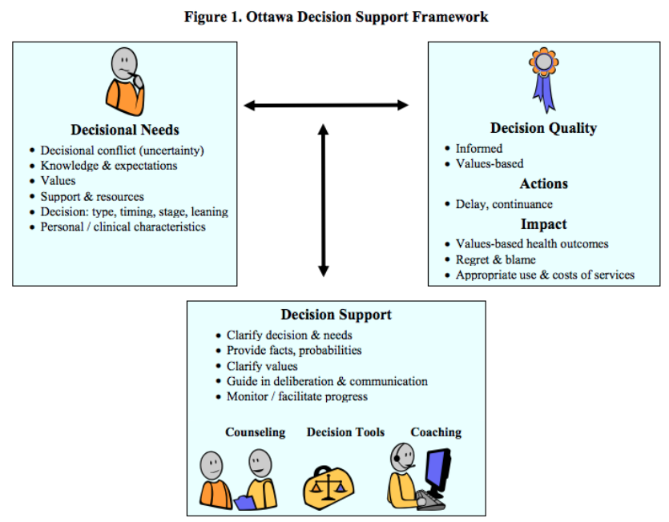
Notes:
On the left is the original 1998 version explaining in detail how determinants of decisions that are suboptimal can be addressed by providing decision support, with the expected effects on the quality of the decision, decision making process, and outcomes of decisions.
On the right is the 2006 version, simplifying the first two columns, and trimming back evaluation to the essentials.
In a nutshell, the premise of the framework is that participants’ unresolved decisional needs can adversely affect decision quality, and subsequent actions, and impacts. Decision support can improve decision outcomes by addressing decisional needs using the appropriate combination of clinical counseling, decision tools and/or decision coaching.
The next slides drill down into each of these 3 elements.

Slide 9
Decisional Needs
• Decisional conflict Uncertainty best course of action • Inadequate knowledge condition, options, benefits, risks, scientific uncertainties • Unrealistic expectations perceived likelihood benefits/risks not aligned with evidence • Unclear values personal importance of benefits, risks, scientific uncertainties • Decision characteristics (type, timing, stage, leaning) can amplify needs: | Inadequate Support & Resources | Personal/Clinical Characteristics that amplify needs
Notes:
3 columns show needs related to the Decision, Support & Resources, and Personal/clinical characteristics.
In the first column, there is
Decisional conflict
Inadequate knowledge of key facts needed to make decision
Unrealistic expectations where perceived likelihood of benefits and risks exaggerated or minimized compared to the evidence
Unclear values or personal importance of benefits, risks, scientific uncertainties;
Decision characteristics can amplify needs, for example,
some types increase decisional conflict;
urgent decisions can be more difficult.
stage of decision making affects patients’ receptivity to information/deliberation due to denial, hasty decision making, premature closure, or polarized leaning

Slide 10
Decisional Needs
• Decisional conflict Uncertainty best course of action • Inadequate knowledge condition, options, benefits, risks, scientific uncertainties • Unrealistic expectations perceived likelihood benefits/risks not aligned with evidence • Unclear values personal importance of benefits, risks, scientific uncertainties • Decision characteristics (type, timing, stage, leaning) can amplify needs: | Inadequate Support & Resources • Unclear/biased perceptions of others’ opinions/practices • Social pressure to choose one option • Mismatch in preferred/actual decision-making roles • Inadequate experience, confidence, motivation, skill for making/implementing decisions • Inadequate access to information, advice, emotional support, instrumental help, financial assistance, health and social services | Personal/Clinical Characteristics
Notes:
Inadequate support or resources (e.g.,
unclear/biased views of others,
social pressure,
mismatch in a patients’ preferred decisional role ad actual role,
inadequate experience, confidence and skills in decision making; and
inadequate access to information, emotional support, instrumental help and other resources

Slide 11
Decisional Needs
• Decisional conflict Uncertainty best course of action • Inadequate knowledge condition, options, benefits, risks, scientific uncertainties • Unrealistic expectations perceived likelihood benefits/risks not aligned with evidence • Unclear values personal importance of benefits, risks, scientific uncertainties • Decision characteristics (type, timing, stage, leaning) can amplify needs: | Inadequate Support & Resources • Unclear/biased perceptions of others’ opinions/practices • Social pressure to choose one option • Mismatch in preferred/actual decision-making roles • Inadequate experience, confidence, motivation, skill for making/implementing decisions • Inadequate access to information, advice, emotional support, instrumental help, financial assistance, health and social services | Personal/Clinical Characteristics Special needs due to: • Age, development stage, gender, ethnicity • Education, occupation, locale, socioeconomic status, marital status • Diagnosis and duration of condition • Health status (limitations in physical, emotional, cognitive, social functioning)
Notes:
And finally, special needs arising from patients' personal or clinical characteristics including
Their sociodemographic profile outlined in the first 2 rows,
As well as
Clinical diagnosis, duration, and functional limitations

Slide 12
Decision Support
(clinical counseling, decision tools, coaching)
Clarify decision & decisional needs Provide facts, probabilities Clarify personal values Guide in deliberation and communication Monitor (stage, needs) & facilitate progress
Notes:
Decision Support is structured assistance in deliberation and communication, that is tailored to the patient's decisional needs.
The aim is to reach a decision that is based on patients’ informed values.
Depending on context, decision support includes clinical counselling which may be accompanied by decision tools and/or coaching.
Underpinning each approach is a process designed to
Clarify the decision and assess the patient's decisional needs
Provide information and probabilities on outcomes to address knowledge deficits and unrealistic expectations;
Clarify personal values by describing other patients' experiences of the outcomes or asking them to rate the personal importance of these outcomes;
Guide in deliberation and communication;
Monitor stage of decision making and needs, as well as facilitating progress in decision making and implementation. The SURE tool can be used to monitor decisional needs.

Slide 13
Decisional Outcomes
Decision Quality Informed -Knowledge of key facts: condition, options, benefits, harms, scientific uncertainties? -Accurate risk perceptions? Values-based Match between chosen option and positive/negative features that matter most to informed patient? | Actions Delay/make the decision? Continue/adhere to chosen option? | Impact Values-based health outcomes Achieve positive outcomes that matter most or avoid negative outcomes that matter most Regret & blame Appropriate Use & Costs of Services • Reduce overuse of options that informed patients don’t value • Improve underuse of options that informed patients value
Notes:
How is decision support evaluated? The primary outcome is decision quality, or informed values-based decisions. Operationally, this means that the patient knows key facts and has accurate risk perceptions, and
there a match between the chosen option and the positive/ negative features that matter most
Other outcomes include:
Actions, such as delaying the decision and continuing with their chosen option, as well as
Impacts of these decisions and actions, such as
Achieving values-based health outcomes e.g.
Did the patient achieve positive outcomes that matter most or avoid negative outcomes that matter most?
Minimizing regret or blame
Using health services appropriately and related costs e.g.,
Reducing over-use of options that informed patients don't value and increasing underuse of options that they do value
There are no DM process measures, as the monitoring tools for decisional needs and stage are included in the intervention.

Slide 14
3. Current ODSF limitations
Needs updating
  More decisions & countries
  Rigorous methods: systematic review
Priorities:
  Decisional Needs Categories
  Effects of Pt Decision Aids on: DM Process, DQ, Actions, Impact
  Performance of DCS
Notes:
What are its current limitations?
The framework needs updating with more diverse decisions in more countries
Using more rigorous search methods: systematic review
Priorities include: needs, effects decision aids on DM Process, DQ, Actions, Impact… I am curious to know if my trimming back of DM process variables in the 2006 version us still warranted.
And the use and performance of the DCS

Slide 15
References
1989-93: O’Connor, A., & O'Brien-Pallas, L.L. "Decisional Conflict", in G.K. McFarland and E.A. McFarlane (eds), Nursing Diagnosis and Intervention (Toronto: The C.V. Mosby Company, 1989, revised 1993. Revised 1993
1990: O’Connor AM, D’Amico M. Decisional conflict. In McFarland GK, Thomas MD (eds). Psychiatric Mental Health Nursing: Application of the Nursing Process. Philadelphia: J. B. Lippincott, 1990.
1998: O’Connor A, Tugwell P, Wells G, Elmslie T, Jolly E, Hollingworth G, McPherson R, Bunn H, *Graham I, Drake E. A decision aid for women considering hormone therapy after menopause: Decision support framework and evaluation. Patient Education and Counselling. 33(3):267-279, March 1998.
2006: *Légaré F, O’Connor AM, Graham ID, Wells G, Tremblay S. Impact of the Ottawa Decision Support Framework on the agreement and the difference between patients and physicians decisional conflict. Medical Decision Making. 2006 Jul-Aug;26(4):373-90.
2009: O'Connor AM, Legare F. Decisional Conflict. Kattan MW (Ed), Encyclopedia of Medical Decision Making. Vol 1. Thousand Oaks, CA: Sage Publications; 2009.
Stacey D, Higuchi KAS, Menard P, et al. Integrating patient decision support in an undergraduate nursing curriculum: An implementation project. International Journal of Nursing Education Scholarship 2009;6(1):1-18.
2016: Loiselle M-C, Michaud C, O'Connor AM. Decisional Needs Assessment to Help Patients with Advanced Chronic Kidney Disease Make Better Dialysis Choices. Nephrology Nursing Journal. 2016;43(6):493.
Notes:
Thank you for listening. Good luck with your own projects!

